Slide 1
Escape Room - Matrix
Team 4

Slide 2


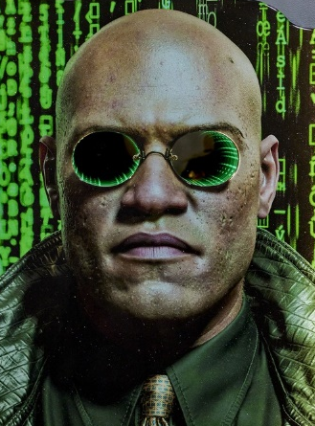

The Agents
Tiago Pedro
Nicole Pinto
Mehdi Sahraoui
Manuel Ramos

Slide 3
Project Overview
Coding, functions and game engine were already done
We just added the missing variables
We imported from IPython.display import clear_output
We imported the library OS (subprocess.run) and (os.system) to cls clear screen (jupyter notebook)
We added a timer to the game start the game with 30 mins and everytime we do a wrong move 1 minute reduction

Slide 4
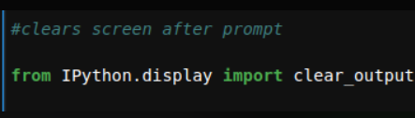
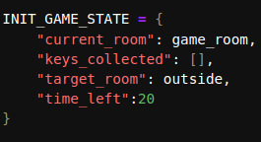

Project Overview

Slide 5
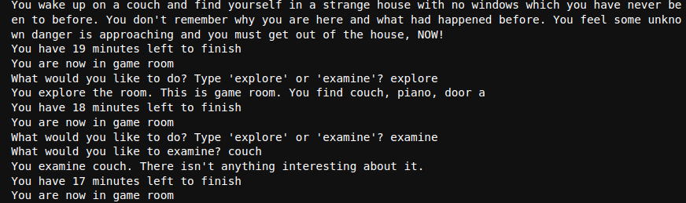
Technical Challenge
Challenge 1: Every time we type something, it printed results and went to the next step. So we had a big list and it did not look refined
Solution: We used the from IPython.display import clear_output

Slide 6

Technical Challenge
Challenge 2: ‘door d’ was not defined
Solution: We changed the order in which we defined the order for variables for the rooms

Slide 7
Big Mistake
Incorrect Syntax
Iteration
Spelling Errors
Notes:
solution: defining the living room

Slide 8
Lessons Learnt
It is important to clearly define the variables and functions
Functions should be as descriptive so that the user understand it
We discussed about .args and .kwargs and we concluded that we could not use it our current code
We exchanged a lot of learning resources available on the internet

Slide 9
Demo Slide
Link: https://colab.research.google.com/drive/1e1X42iAgfP3Pz0lzutYW4eIbvdZobs2G?usp=sharing

Slide 10
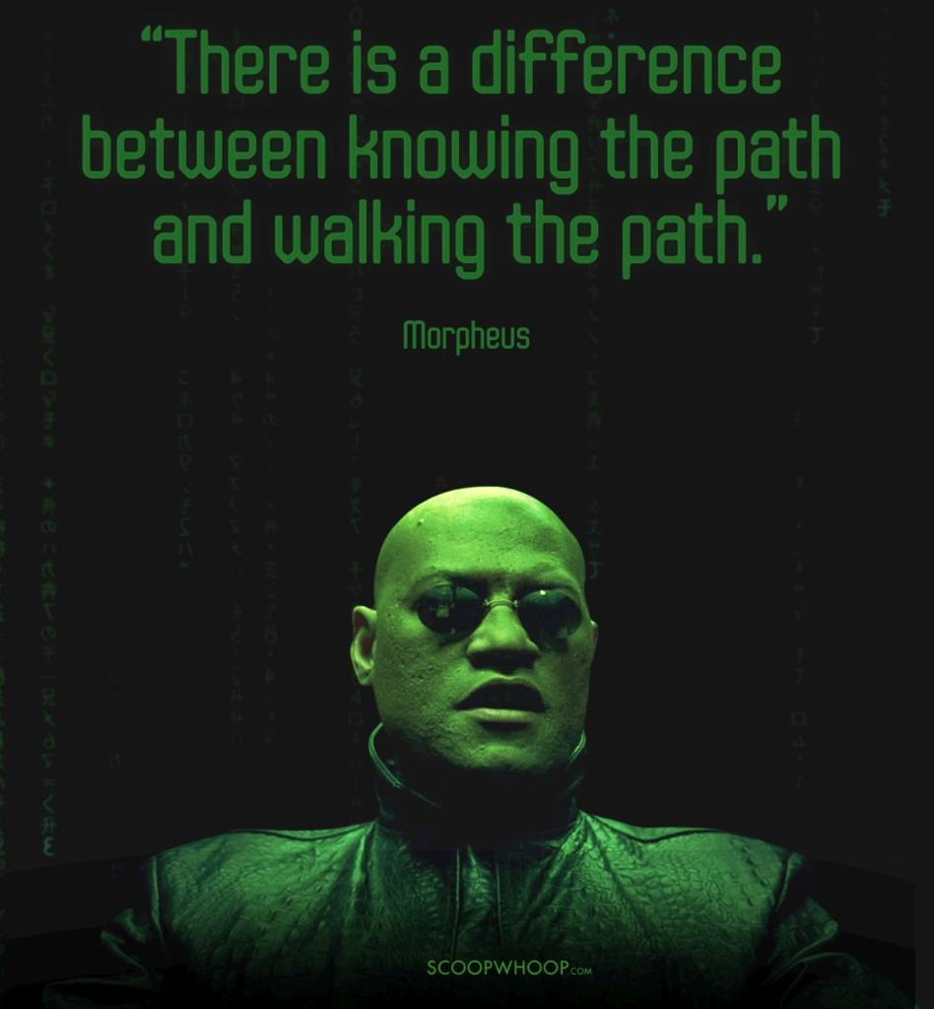

Slide 11
THANKS FOR YOUR ATTENTION

